Slide 1



#APAChapters

Slide 2
Chapter Operations
and
Marketing

Slide 3
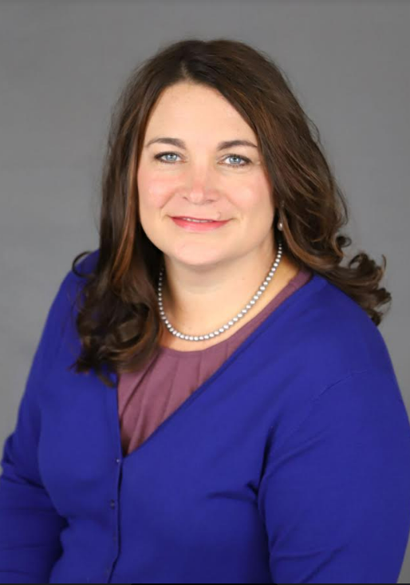
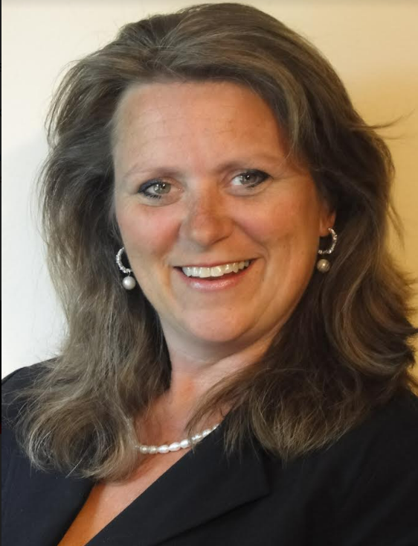
Instructors
Stephanie Ernsting, CPP
Michelle Ganzer, CPP
Director of HR Shared Services
Amcor Flexibles North America, LLC
Payroll and Tax Compliance Manager
Johnson Controls, Inc

Slide 4
1
Chapter Leadership
2
Chapter Marketing
3
Chapter Operations
4
Chapter Resources available

Slide 5
Six Fundamental Chapter areas to focus on
Chapter Management
Membership Services and Development
Educational Planning
Government Services
Service to the Payroll Profession
Service to the American Payroll Association

Slide 6
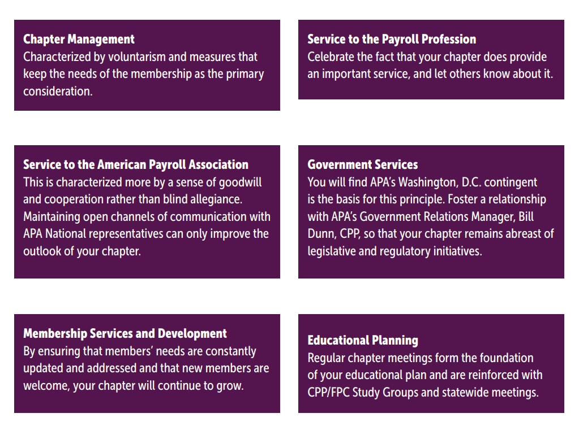
Six Fundamental Chapter areas to focus on

Slide 7
Chapter Leadership

Slide 8
Leadership & Teamwork = Success
Board of Directors
Bylaws
Officers
Committees with Committee Chairs
Membership

Slide 9
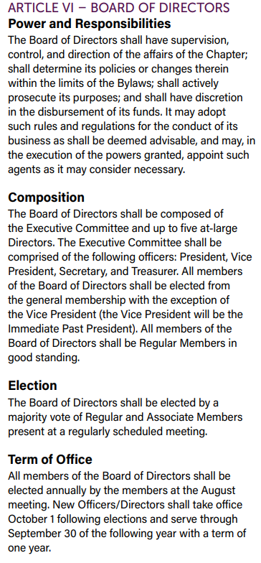
Board of Directors
Power and Responsibilities
Composition
Election & Term of office
Meetings
Voting
Example

Slide 10
By-laws
Review each year
Do not include specifics that can change often (such as annual fee)
Ask lawyer or BoA to review
Know the percentages in order to take and pass a vote

Slide 11
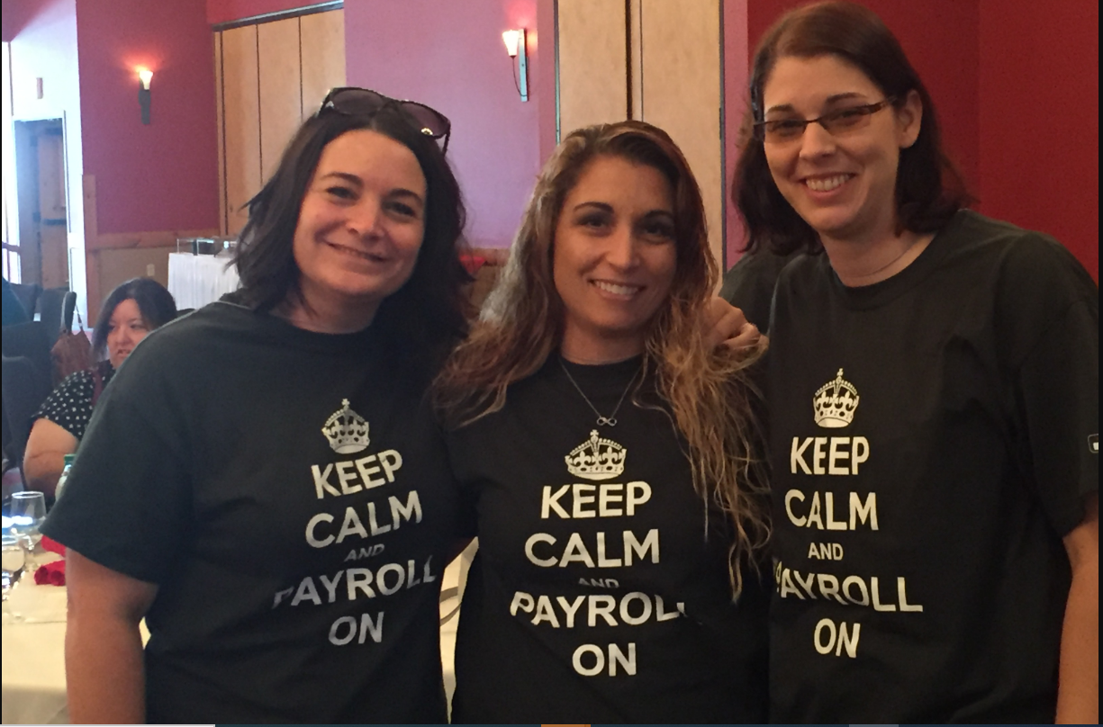
Officers
Elections & Term of Office
Responsibilities
Job Descriptions
Expectations
Removal
Transition to new officers
Example

Slide 12
Committees/Chairs & Descriptions
Chair requirements
National Member
Member of the Board
Attend meetings
Transition to new Chairs
Chair requirements
GLO & NPW Campaign Manager
Others: Website, Study Group, Educational, Membership, Statewide, Community Involvement, Contest, ByLaws, Program
Example

Slide 13
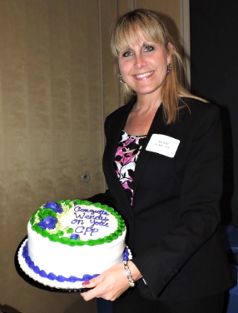

Membership
Member Benefits
  Recognize members, Discounts, Give back
Mentor & Empower
  Develop Professionally
Recruit volunteers
Membership growth and Retention
  Guest Challenge, Alumni Reunion, Survey
Example

Slide 14
Chapter Marketing

Slide 15
Maintain your interest and enthusiasm – these are the most essential ingredients in starting a successful local chapter of APA. You’ll find that your desire can become contagious if you have a positive attitude!

Slide 16

Who should Market the Chapter?
Everyone associated with the chapter should market!
  Key tips to energize a chapter
Vendor Relationships
  Feature vendors, Speakers and Sponsorship
  Vendor User Group Meetings and Education Meetings
Employers, Schools and Public Locations

Slide 17
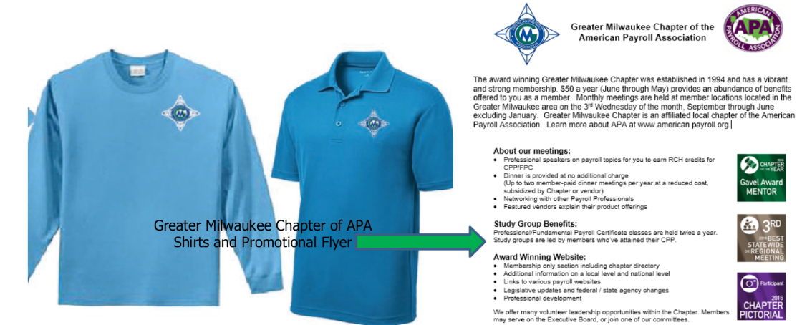
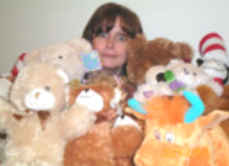
How to Market?
Traditional:
  Brochures, Newsletter, Mailings, Merchandise
Activities
  Study Groups, Conferences, Community Services, NPW, Meetings
Social Media and Website
Example

Slide 18
Lessons learned
National listing – twice a year
Chapter Contests
“Bring a friend”
Internet search for largest companies
Local Chambers
Physical mailings

Slide 19
Chapter Operations

Slide 20
Education of its members is the foremost goal of APA National

Slide 21
Required Operations
Education – Speakers, Meetings, Study Groups, NPW
Excellent Communication
Get the back office in order
Officer/Board/Committee Responsibilities defined
Bonding insurance
Finances – Dues, Budget, Bank Account, Tax status
Calendar of events/meetings/Community involvement

Slide 22
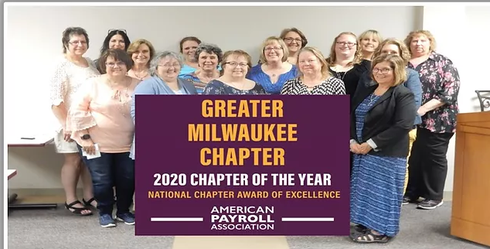
Be Prepared
Brag about your successes
  Educational Grants, Contests, PAYTECH’s Chapter Network,
Succession planning
  Recruiting
    College students/new Payroll professionals
Plan for the future
  Hybrid meetings/Virtual voting/Re-Affiliation
Example

Slide 23
Chapter Resources available

Slide 24
Local chapters - to provide services to the area’s APA members that complement the activities of APA

Slide 25
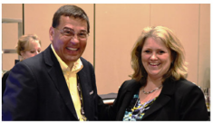
APA Guides
National APA
  Guides & Chapter Policy Statement
  Chapter Leaders Blog
  Board of Advisors/Regional Groups
APA Chapters
  Find a Chapter, Find a Chapter Event, Grow Your Chapter
  Chapter Mentor Program/CHAMPS

Slide 26
Stephanie Ernsting, CPP
  920-527-7941
  Stephanie.ensting@amcor.com
Michelle Ganzer, CPP
  414-698-3626
  michelleganzer@gmail.com
Example

Slide 27
Thank You!

